Slide 1
COVID-19 Vaccines, Variants... Oh My!
Elizabeth Prom-Wormley, MPH, PhD
Assistant Professor
Division of Epidemiology
Department of Family Medicine and Population Health
Virginia Commonwealth University
Elizabeth.Prom-Wormley@vcuhealth.org

Slide 2
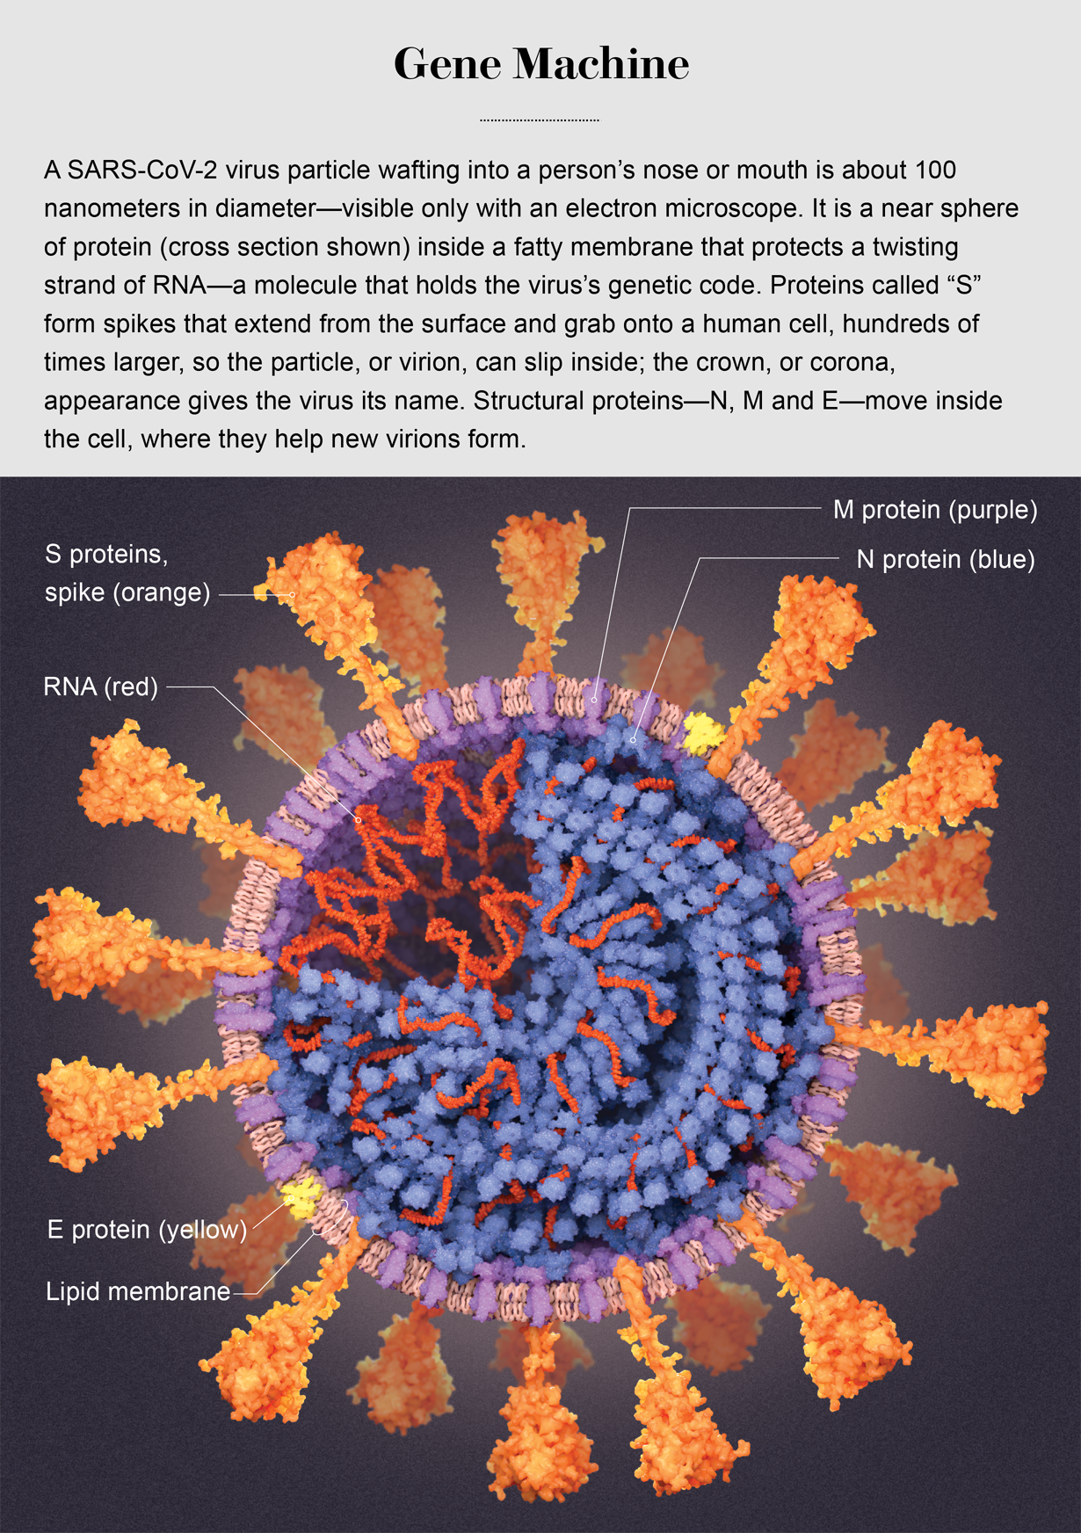
What is an mRNA vaccine?
An mRNA vaccine is one type of vaccine technology to protect people from the SARS-CoV-2 virus
An mRNA vaccine injects manufactured mRNA into the muscle cells of a person (usually at the arm)
The mRNA in the vaccine has been manufactured with information to make replicas of the spike protein that are at the outside of the coronavirus
Figure 1. Image of a SARS-CoV-2
Figure 1. The target of the mRNA
Vaccine: The SARS-CoV-2 spikes
https://www.scientificamerican.com/article/a-visual-guide-to-the-sars-cov-2-coronavirus/

Slide 3
How Does an mRNA Vaccine Work?
The mRNA vaccine, like other vaccines, trains our immune system to recognize one part of the virus as dangerous and leads to a response to kill an actual SARS-CoV-2 virus if it enters our body
The vaccine contains hundreds of copies of manufactured mRNA which is wrapped inside a tiny fat (lipid) bubble.
The manufactured mRNA contains the instructions to ONLY make the the SARS-CoV-2 spike protein
The vaccine trains our immune system to recognize only one part of the virus—the spike protein—as something foreign.
https://www.cdc.gov/vaccines/hcp/conversations/downloads/vacsafe-understand-color-office.pdf

Slide 4
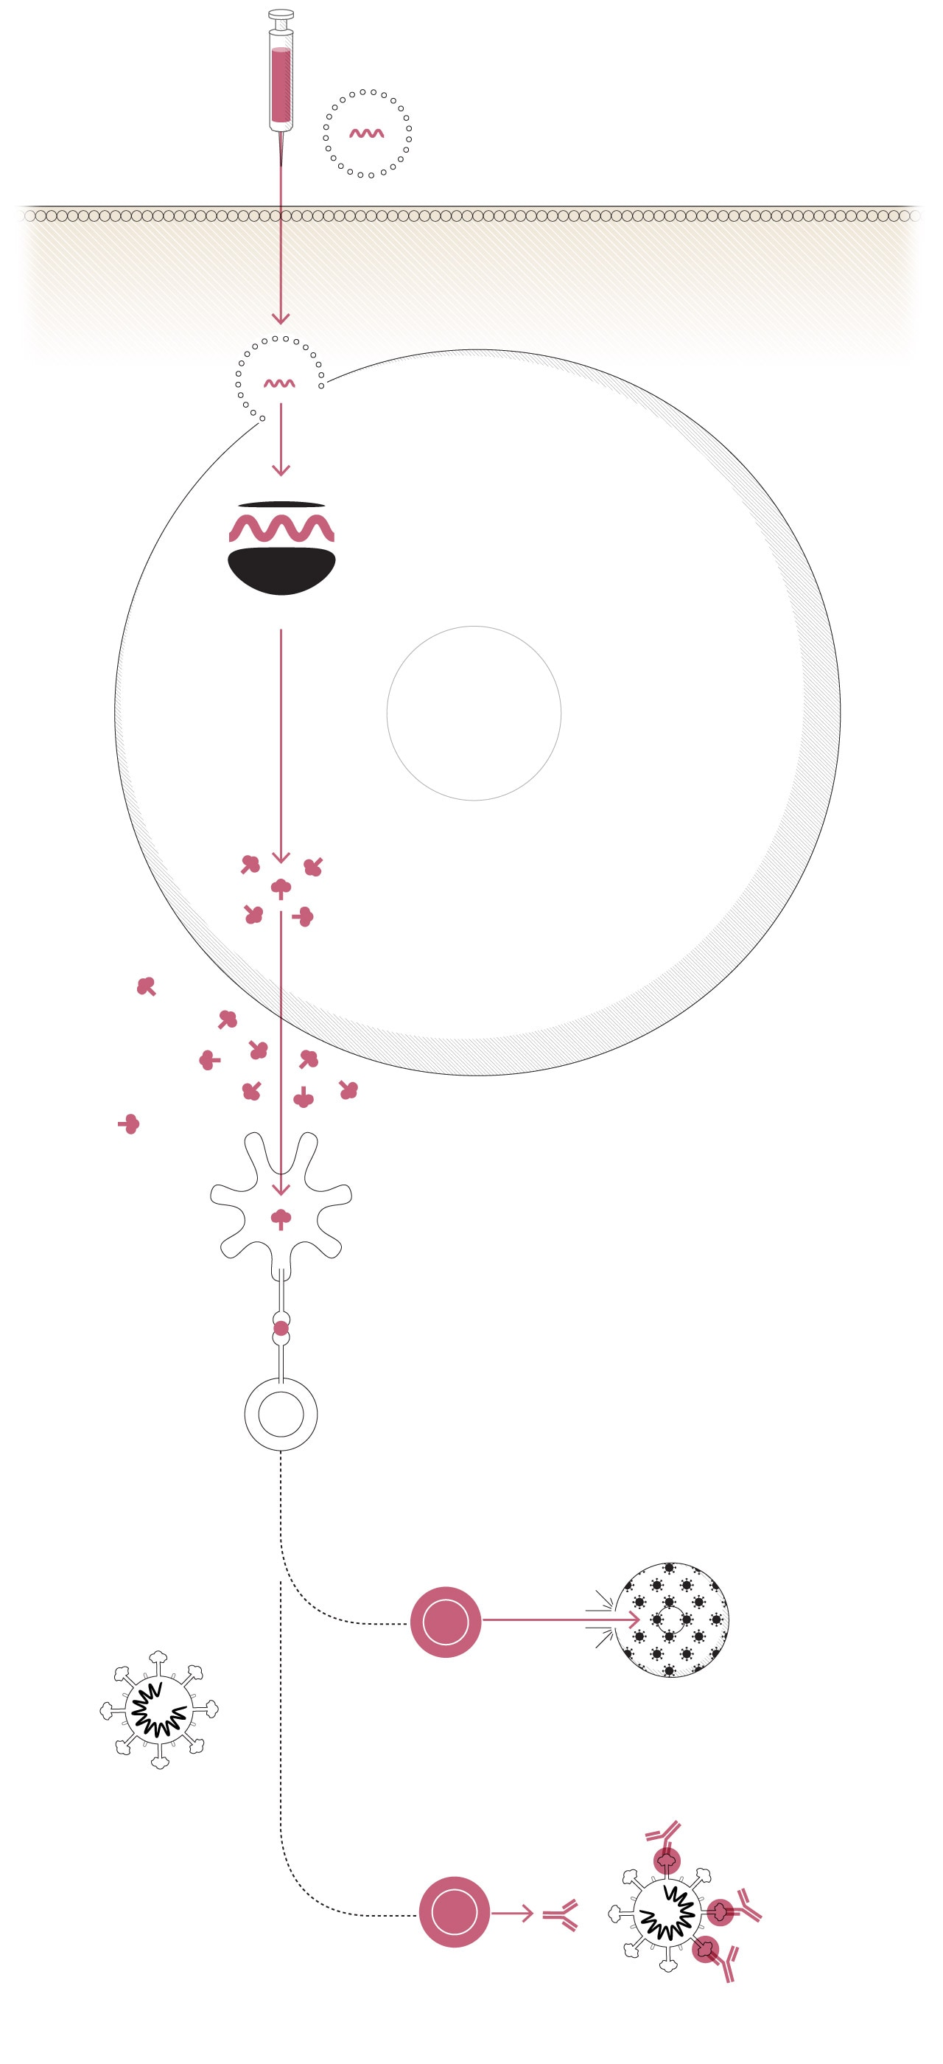
How does an mRNA
Vaccine Work?
Step 1
Step 2
Step 1- Injection. Vaccine is injected into the arm.
Step 2- mRNA Entry. Manufactured mRNA enters the muscle cells at the site of injection by absorbing the fat (lipid) bubble.
Step 3- Spike Protein Production. Once the mRNA is inside the cell, ribosomes read the mRNA instructions to make the spike protein and the other cell parts make the spike protein.
Step 4- Begin Immune System Training. The cell releases SARS-CoV-2 spike proteins which are consumed by antigen-presenting cells (APC). The APC sends information to the immune system that something foreign is in the body by producing viral peptides.
Step 3
Spike proteins
Step 4
APC
T-Helper Cell
https://www.washingtonpost.com/health/2020/12/15/moderna-vaccine-found-safe-effective/

Slide 5
How does an mRNA
Vaccine Work?
Step 1
Step 2
Step 5- Immune System Training Begins! The immune system detects the presence of the viral peptides and begins to train itself against the virus by sending out a smaller army of its defense system- B cells and helper T cells.
Step 6- Real-life Virus Exposure. Once a person is exposed to the actual virus, the helper T cells will remember the spike protein that they had been previously exposed to from the vaccine.
Helper T cells quickly notify (1) cytotoxic T-cells which engulf infected cells and destroy them and (2) B-cells, which previously produced antibodies that block the virus from infecting healthy cells.
Step 3
Spike proteins
Step 4
APC
Helper T-Cell
Step 5
Virus- Infected
Cell
Cytotoxic
T Cell
Step 6
Antibodies
https://www.washingtonpost.com/health/2020/12/15/moderna-vaccine-found-safe-effective/
B Cell

Slide 6
How does an mRNA vaccine work?
Summary: mRNA vaccines use our cells to make copies of the virus spike protein.
mRNA vaccines use our cell parts and processes to read manufactured mRNA and produce a piece of the virus (the spike protein) that can be recognized by the immune system as a threat that must be eliminated
Myth: The COVID-19 vaccine will alter your DNA
Fact: No it won’t.
It doesn’t touch our DNA at all. The mRNA vaccine doesn’t deal with our DNA at all.
The manufactured mRNA can no longer survive after the ribosome reads it.
https://www.cdc.gov/coronavirus/2019-ncov/vaccines/different-vaccines/mrna.html
https://en.wikipedia.org/wiki/Central_dogma_of_molecular_biology

Slide 7
How Many COVID-19 mRNA Vaccine Adverse Events Have Been Reported?
According to Pfizer’s report to the FDA, 0.6% of all participant who received the vaccine had a severe adverse event. 0.5% of all placebo participant had a severe adverse event.
Of all the 43,448 participants that have been enrolled in the Pfizer Phase 2/3 trials, the severe adverse events identified were
  Bell’s palsy (4 cases in vaccine group, none in placebo group)
  Appendicitis (8 in vaccine group [0.04%], 4 in placebo group [0.02%])
  Acute myocardial infarction- 0.02% in vaccine group, none in placebo)
  Cerebrovascular accident (stroke)- 0.02% in vaccine group, none in placebo
  Hypersensitivity-related adverse event likely associated with allergic reaction (137 in vaccine group [0.63%], 111 in placebo group [0.51%])
https://www.fda.gov/media/144245/download
https://www.clinicaltrials.gov/ct2/show/NCT04368728?term=BNT162b2&draw=2&rank=4

Slide 8
Side Effects Update
According to the US Vaccine Adverse Event Reporting System, ~372 out of 1 million doses of mRNA vaccine lead to non-serious reaction report (v-safe/ VAERS)
Pfizer- Approximately 3 anaphylactic reactions per one million
Moderna- Approximately 5 anaphylactic reactions per one million
https://www.nature.com/articles/d41586-021-00290-x

Slide 9
Have mRNA vaccines been found unsafe in the past?
mRNA vaccines were first established in 1989—Plenty of time to have and document adverse events
Causes of adverse events, including death, have generally been due to harmful immune responses and the downstream physiological responses that occur when those immune responses take place
Adverse event possibly are likely to be due to the proteins produced from the mRNA, the material that holds the mRNA before cell entry, or the ingredients in the vaccine that preserve the mRNA (polyethelyne glycol, PEG)
https://www.nature.com/articles/s41579-020-00462-y
https://www.ncbi.nlm.nih.gov/pmc/articles/PMC3597572/

Slide 10
Why have there been severe allergic reactions to the mRNA vaccines?
It is not exactly clear why people with severe allergies are experiencing anaphylactic reactions to the mRNA vaccines. Some think it may be due to the use of polyethylene glycol (PEG)
Generally, exposure to the vaccine causes an inappropriate activation of the immune system in people with very sensitive/reactive systems
As more people take the vaccine and report severe adverse reactions, it will be easier to identify the exact cause
https://www.ncbi.nlm.nih.gov/pmc/articles/PMC3597572/
https://www.nature.com/articles/s41579-020-00462-y

Slide 11
How Many mRNA Vaccines are Currently Available in the United States?
Three
As of 8am, March 23, 2021 vaccines from Pfizer, Moderna, and Johnson and Johnson are approved for distribution in the United States an Emergency Use Agreement
Astra Zeneca is submitting data now for approval

Slide 12
Topic Area: The mRNA vaccines were produced so quickly. Can they be trusted?
Why should I trust this one after an extremely short development period?
How effective is a vaccine synthesized in such a short timeframe?

Slide 13
The mRNA vaccines were produced so quickly. Can they be trusted?
People get frustrated with scientists because we prefer not to oversell. We tend not to answer with a definitive ”YES” or “NO” unless there is substantial evidence to support our conclusion.
This is one of those times
The short is answer is STRONG lean to YES, the vaccine can be trusted.
First, let’s dig into the idea that the mRNA vaccines were produced quickly.
https://www.nature.com/articles/s41586-020-2798-3

Slide 14
The mRNA vaccines were produced so quickly. Can they be trusted?
”Quickly” is relative. There was a lot of background work leading to this
  Development of mRNA vaccine technology actually began in 1989
  Genetic sequencing began in earnest in 1997
  Rapid genetic sequencing was becoming a reality around 2007
  Recent SARS and MERS outbreaks in the Middle East and Asia produced samples that could be sequenced and studied
An international consortium of researchers received a sequence from a Wuhan case on January 11, 2020. Thank you Zhang lab for your courage.
  In 24 hours, they confirmed that the majority of the sequence was related to previously sequenced SARS
  Two days later, the first SARS-CoV-2 vaccine sequence was designed
https://zeynep.substack.com/p/the-pandemic-heroes-who-gave-us-the
https://www.nature.com/articles/s41586-020-2798-3
https://www.ncbi.nlm.nih.gov/pmc/articles/PMC7371592/

Slide 15
The mRNA vaccines were produced so quickly. Can they be trusted?
Because researchers already had the genetic sequence of SARS from previous outbreaks, they only had to identify locations with major differences between already available sequences and SARS-CoV-2
Researchers had already spent over 30 years working on how to deliver mRNA into the body safely and had identified areas of risk as well as issues with preserving the mRNA itself prior to vaccine administration
Researchers had already been testing safety of mRNA vaccines in animal studies, so a quick pivot to study SARS-CoV-2 was not at all difficult or time consuming because the pipeline was already in place. Therefore, these mRNA isn’t really all that “quick”.
https://www.nature.com/articles/d41586-020-02926-w

Slide 16
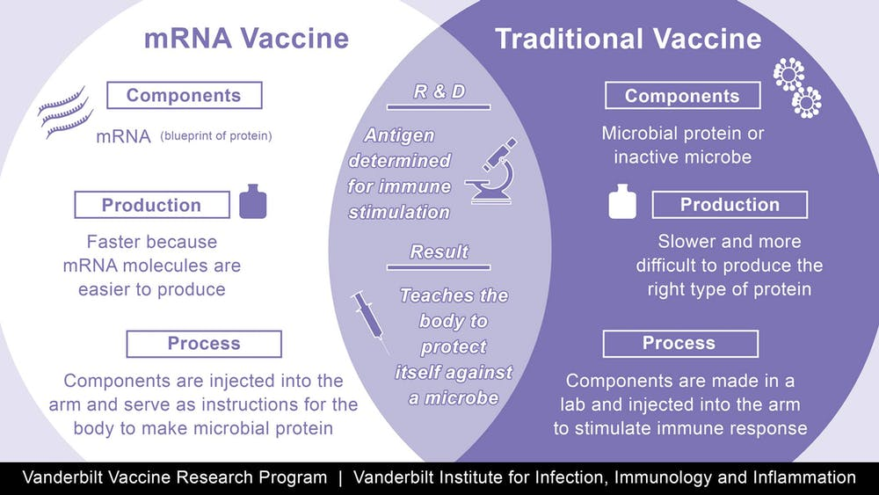
The mRNA vaccines were produced so quickly. Can they be trusted?
It is very understandable how this feels like science fiction compared to prior vaccines which could take almost 17 years to develop
The key to the speed here is the use of genetic information
https://www.marketplace.org/2020/11/23/astrazeneca-vaccine-is-third-to-show-promising-data-in-unprecedented-hurry-up-race/
https://www.nature.com/articles/s41586-020-2798-3

Slide 17
Why should I trust this one after an extremely short development period?
Trust is something I take super serious, and I don’t think you should blindly trust anything.
Take a look at the references shared, consider your own lifestyle and frequency of interactions with others, ask more questions, and decide if you can trust the vaccine as an option for you.
There are a lot of uneasy feelings about these mRNA vaccines but so, far, the data are reasonable to justify that the benefits of the vaccine outweigh the risks for many Americans

Slide 18
Are there other pharmas working on a more effective, safer vaccine?
There are ~50 other vaccines under development around the world using a variety of technologies
Some vaccines are already approved for use in other countries.
We are waiting to determine whether they will be safer or effective.
https://www.raps.org/news-and-articles/news-articles/2020/3/covid-19-vaccine-tracker
https://www.nytimes.com/interactive/2020/science/coronavirus-vaccine-tracker.html?fbclid=IwAR0C1jtiAE7QDKYlgasUTs3W9M4ksGoeaDEKRIVTRRl2BTx1TojAHDY3Gdo

Slide 19
How Does the Johnson & Johnson Vaccine Work?
The Johnson and Johnson vaccine, like other vaccines, trains our immune system to recognize one part of the virus as dangerous and leads to a response to kill an actual SARS-CoV-2 virus if it enters our body
The vaccine contains hundreds of copies of manufactured DNA which are contained inside adenoviruses
The manufactured DNA contains the instructions to ONLY make the the SARS-CoV-2 spike protein
The vaccine trains our immune system to recognize only one part of the virus—the spike protein—as something foreign.
https://www.nytimes.com/interactive/2020/health/johnson-johnson-covid-19-vaccine.html

Slide 20
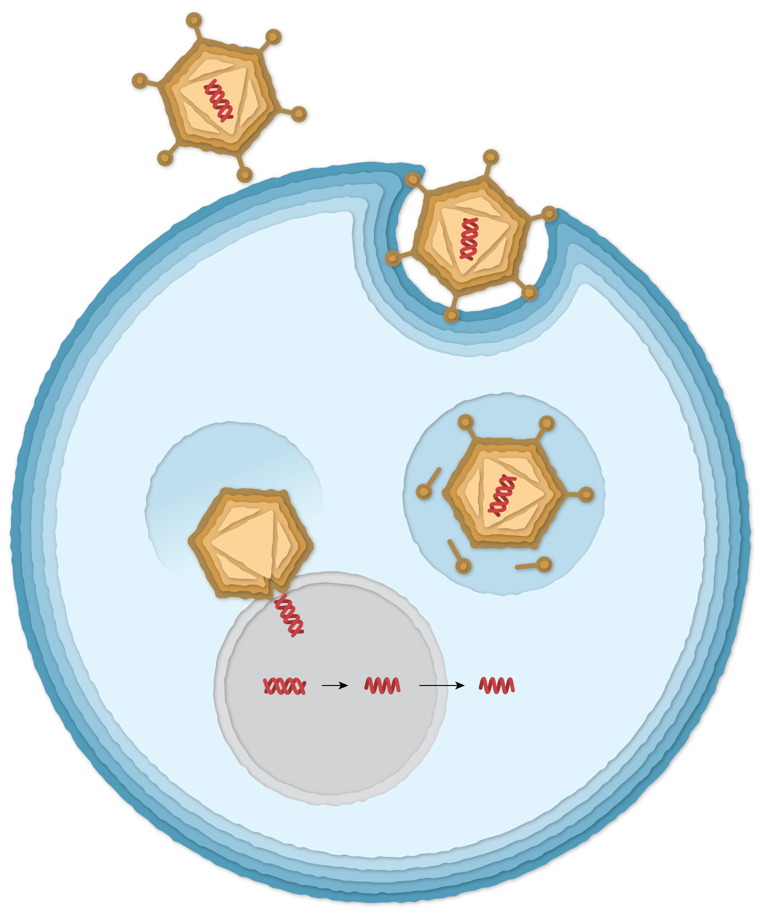
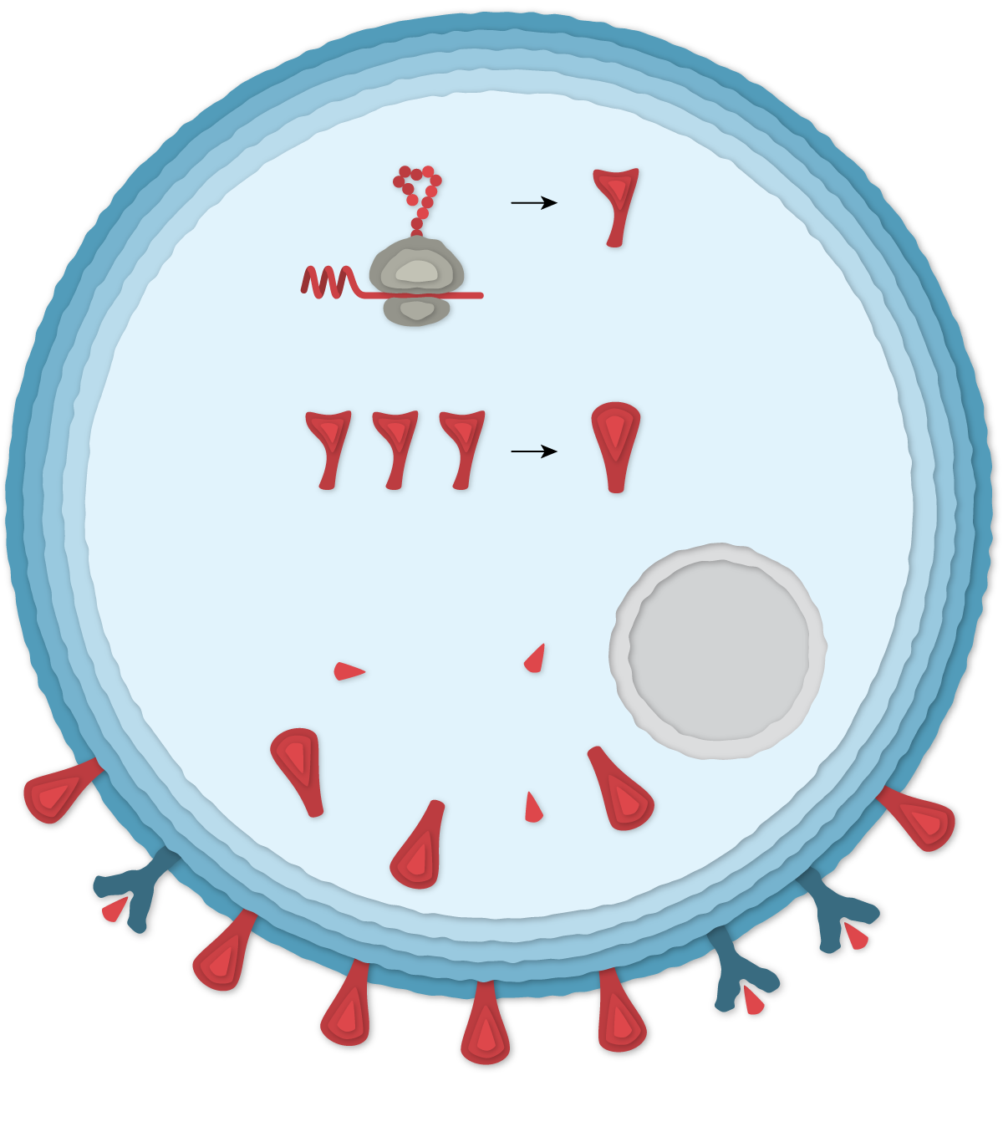
Johnson and Johnson Vaccine
1- Adenovirus with SARS-CoV-2 DNA
tRNA
Spike
protein
4- mRNA
is translated to
Make spike protein
Spike
3-Virus inserts SARS CoV-2 DNA
into cell nucleus
2- Virus engulfed by
cell bubble
5- Three spike proteins combine to make full spike protein
Cell
nucleus
DNA -> mRNA -> mRNA
6- Spike
proteins produced from cells migrate to cell surface
https://www.nytimes.com/interactive/2020/health/johnson-johnson-covid-19-vaccine.html

Slide 21
How does the Johnson & Johnson
Vaccine Work?
Step 1- Injection. Vaccine is injected into the arm.
Step 2- DNA Entry. Adenovirus containing manufactured DNA enters the muscle cells at the site of injection by engulfing the adenovirus.
Step 3- Spike Protein Production. Once the DNA is inside the cell, the cells own machinery reads the DNA instructions to make the mRNA that will eventually be used to make the spike protein
1- Adenovirus with SARS-CoV-2 DNA
3-Virus inserts SARS CoV-2 DNA into cell nucleus
2- Virus engulfed by cell bubble
DNA -> mRNA -> mRNA
https://www.nytimes.com/interactive/2020/health/johnson-johnson-covid-19-vaccine.html

Slide 22
How does the Johnson & Johnson
Vaccine Work?
Step 3- Spike Protein Production. Once the DNA is inside the cell, the cells own machinery reads the DNA instructions to make the mRNA that will eventually be used to make the spike protein
tRNA
Spike
Protein
piece
4- mRNA
is translated to
Make spike protein
Full Spike
5- Three spike proteins combine to make full spike protein
Cell
nucleus
6- Spike
proteins produced from cells migrate to cell surface
https://www.nytimes.com/interactive/2020/health/johnson-johnson-covid-19-vaccine.html

Slide 23
How does the J&J Vaccine Work?
Step 1
Step 2
Step 4- Begin Immune System Training. The cell releases SARS-CoV-2 spike proteins which are consumed by antigen-presenting cells (APC). The APC sends information to the immune system that something foreign is in the body by producing viral peptides.
Step 5- Immune System Training Begins! The immune system detects the presence of the viral peptides and begins to train itself against the virus by sending out a smaller army of its defense system- B cells and helper T cells.
Step 6- Real-life Virus Exposure. Once a person is exposed to the actual virus, the helper T cells will remember the spike protein that they had been previously exposed to from the vaccine.
Helper T cells quickly notify (1) cytotoxic T-cells which engulf infected cells and destroy them and (2) B-cells, which previously produced antibodies that block the virus from infecting healthy cells.
Cell producing
spike protein
Step 3
Spike proteins
Step 4
APC
Helper T-Cell
Step 5
Virus- Infected
Cell
Cytotoxic
T Cell
Step 6
Antibodies
B Cell

Slide 24
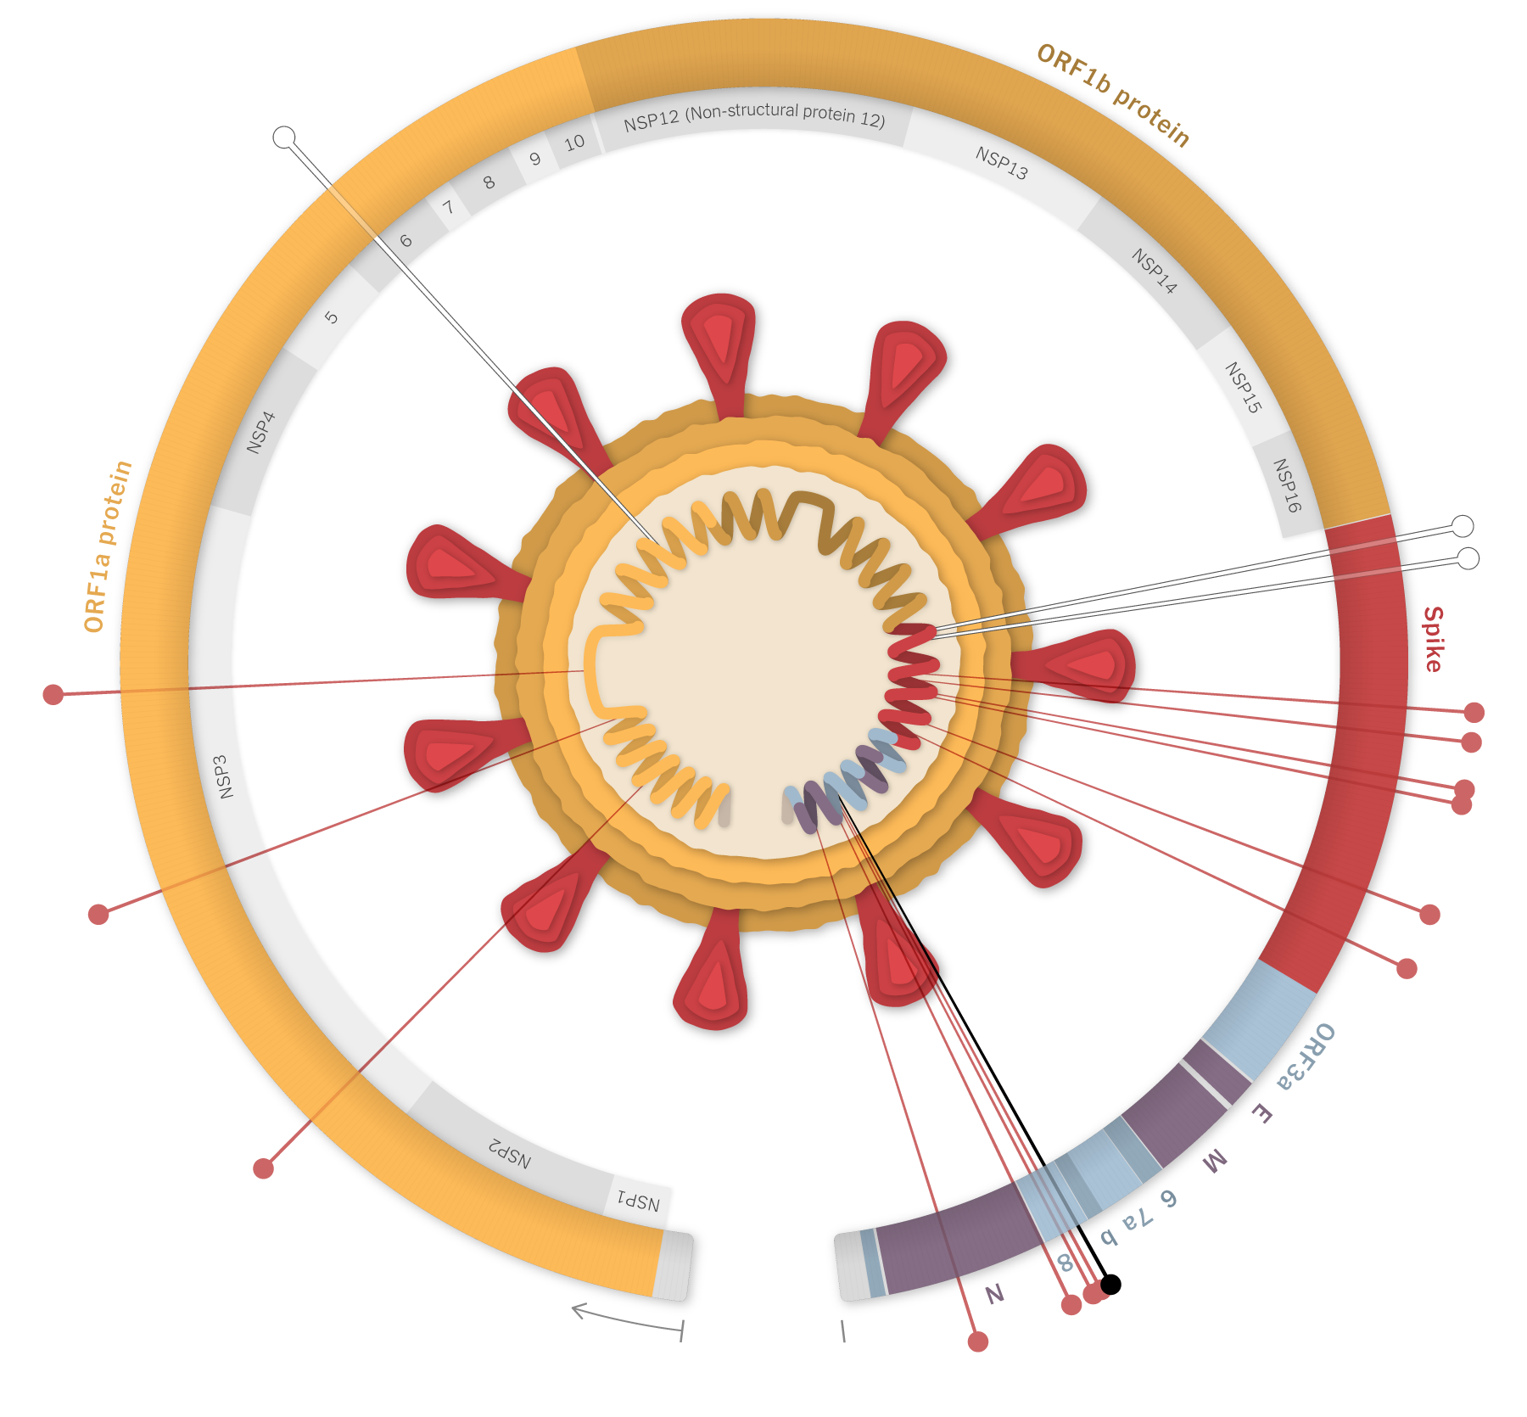
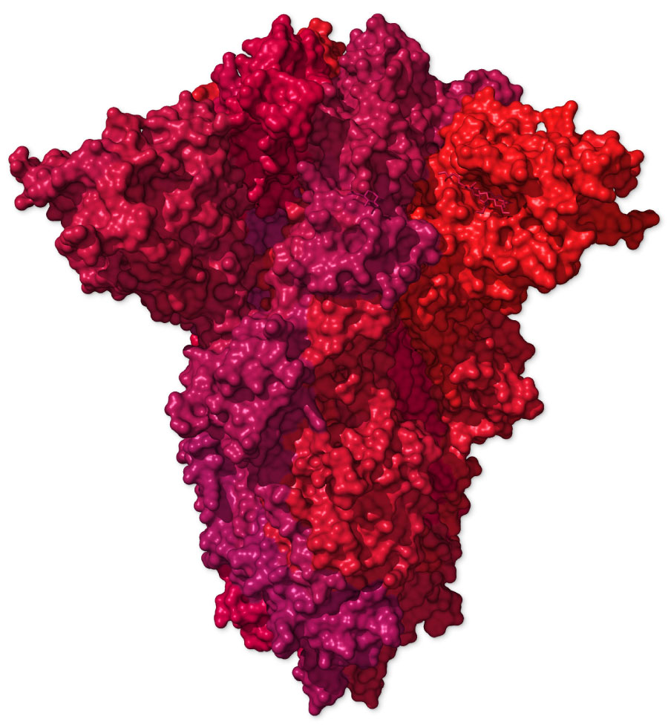
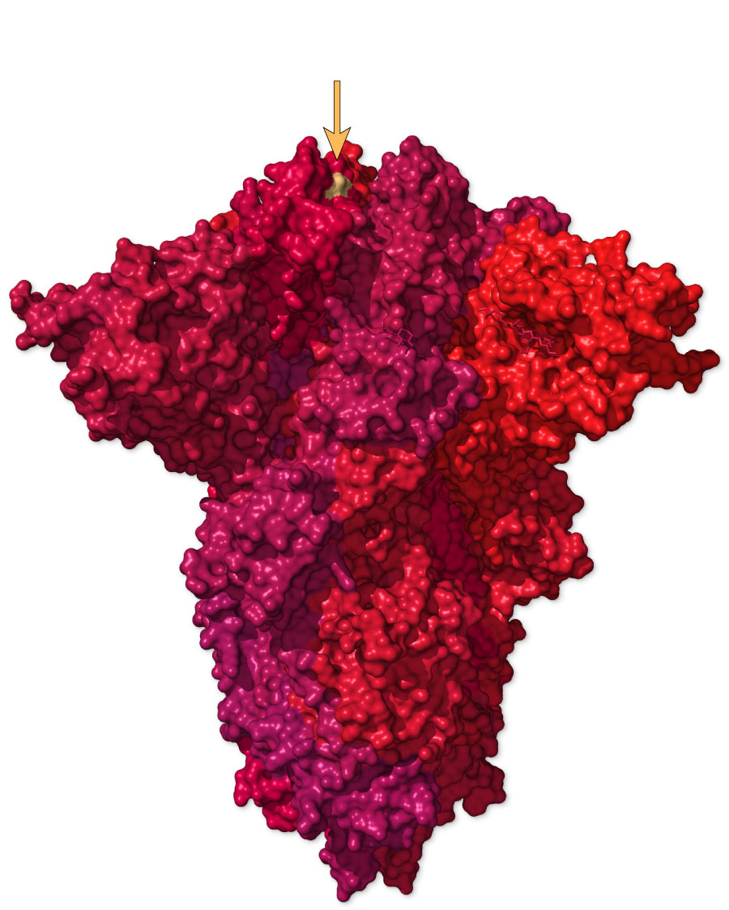
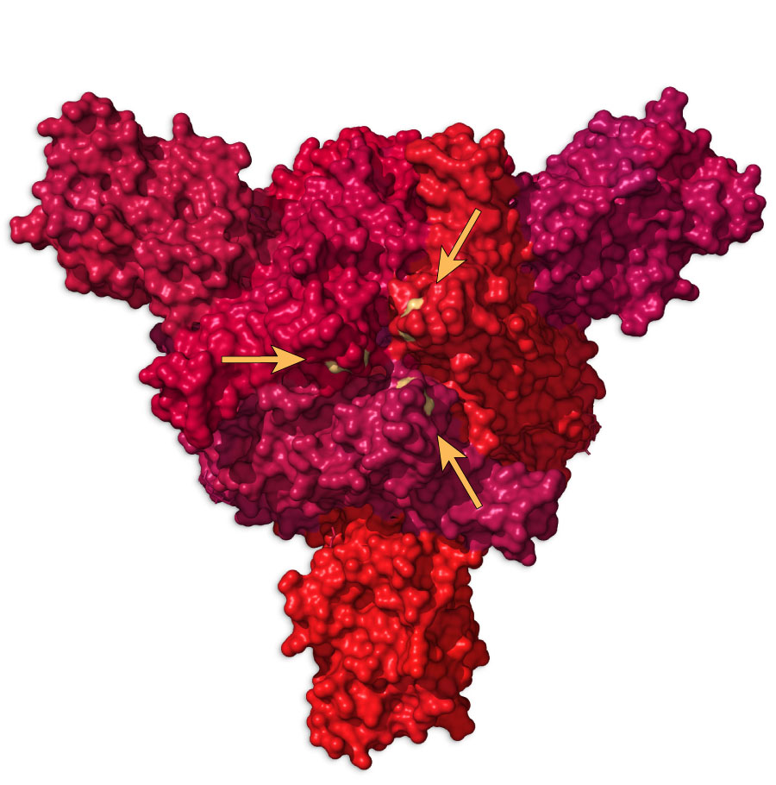
A Sneak Peek into the B 1.1.7 Variant (strain)
Mutated Spike Protein
Typical Spike Protein
Side View
Top View
*
This single mutation causes a change in spike protein due to change at N150Y. It is thought that this change allows the spike protein to attach to our cells more tightly
17 mutations in B 1.1.7
Each dot represents a location where there is a mutation. The blue star shows the one location that produces the protein change seen on the right

Slide 25
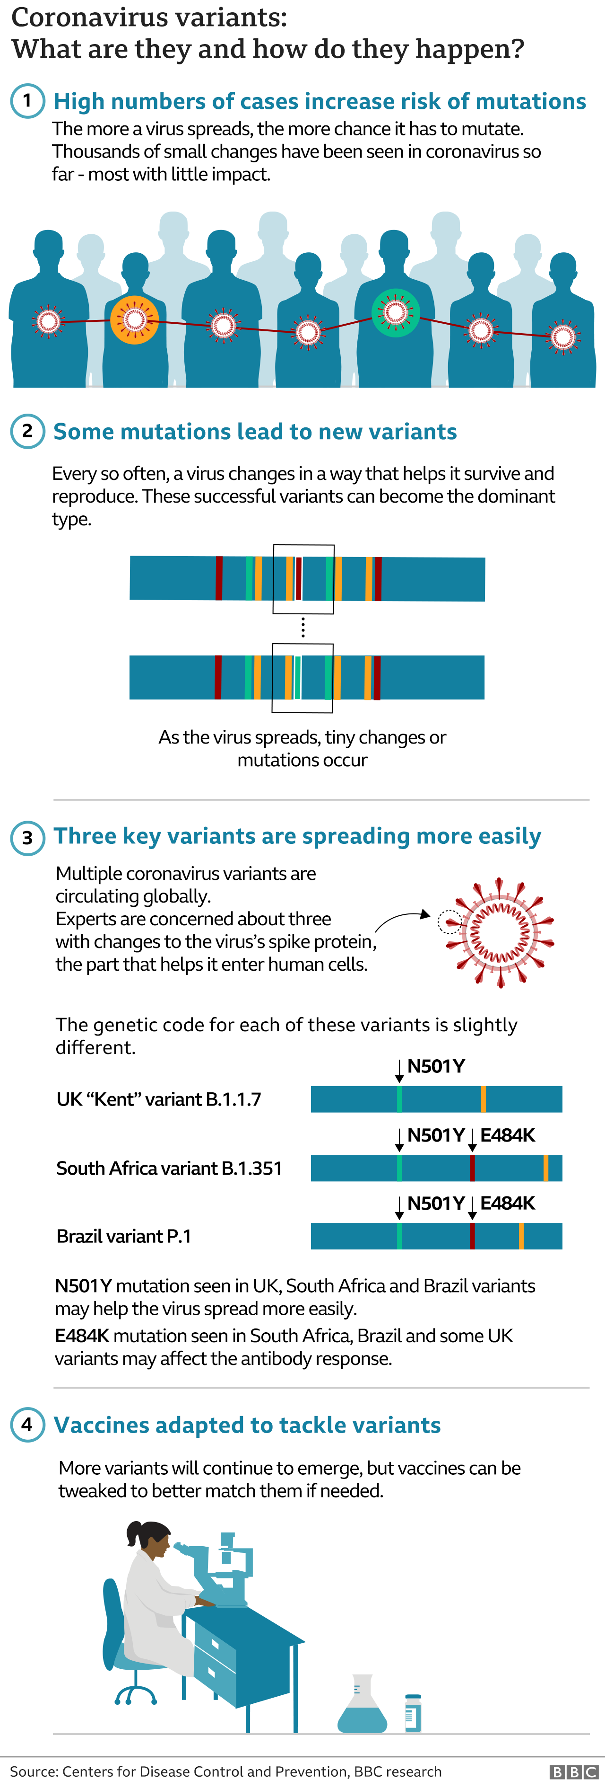
B1.1.7 is Just One Variant
South Africa- B.1.351
Brazil- P.1

Slide 27
Talking About the Vaccines
You will not win a discussion by discussing data because the data are still under development
Consider understanding why a person is hesitant first
  Current health conditions
  Fear
  Variants are coming, so why bother?
  Religious concerns

Slide 28
Consider Sharing Knowledge and Stories
Trusted information resources
VDH has a hotline- 877-ASK-VDH3
Share your own stories and acknowledge your own areas of concern and how you worked past them
Still not ready? You’ll be there whenever they are.

Slide 29
Thank You!

Slide 30
Follow-Up Questions
Where can I travel during COVID-19? https://travel.state.gov/content/travel/en/traveladvisories/ea/covid-19-information.html
  https://www.cdc.gov/coronavirus/2019-ncov/travelers/map-and-travel-notices.html
  https://www.cdc.gov/coronavirus/2019-ncov/travelers/testing-air-travel.html
How soon after receiving another vaccine (e.g., flu) can a person take the COVID-19 vaccine?
  The current recommendation from the CDC and others is 14 days
  https://www.cdc.gov/flu/season/faq-flu-season-2020-2021.htm#Administering-Flu-Vaccines-During-the-COVID-19-Pandemic

